Slide 1
Fiction Passion Board

Slide 2
Fiction Passion Board
Submitted by:-
Ayushi Batham ( 191500204 )
Vani Jain ( 191500893 )
Vasundhara Tiwari ( 191500902 )
Supervised by :-
Mr. Amir Khan
( Technical Trainer )

Slide 3
Reading is a conversation.
All books talk. But good book listens as well.
Books are uniquely portable magic.

Slide 4

OUTLINE
INTRODUCTION
Main Idea
Major Application Area
BASIC COMPONENT USED IN THIS PROJECT
ROADMAP
BASIC WEBSITE FUNCTIONALITY
Landing Page
Book Catalogue Page
Book Details View
Add Rating Activity
View Rating Activity
Add Book activity
SWOT ANALYSIS
LIVE DEMO SESSION
CONCLUSION

Slide 5
INTRODUCTION
Currently in our society, the people used to search for the books in the library as per their interest which becomes very frustrating to find. There is no central system within our reach which allow user to search for the books which they will find interested in reading. We are totally dependent on the views of our friends, colleagues, family, etc. to know some good books to read which results in confusing reviews of some books.
We are going to design a system for a library which will keep track of the user rating’s and their reviews for the books they are reading. This will help user to know more about the content of the book before reading. As well as we will provide a system where user’s can rate the books after reading which will be a source of information for other users. We will be designing a website which will facilitate the readers of the books as well as the library administrator.

Slide 6
MAJOR APPLICATION AREA
BY BOOK READERS FOR ADDING RATINGS TO THE BOOKS THEY HAVE READ
BY LIBRARY ADMINISTRATOR FOR ADDING BOOKS TO THE SYSTEM.

Slide 7
BASIC COMPONENTS USED
VS Code: It is a code editor redefined and optimized for building and debugging modern web and cloud applications.
MERN Stack:MERN is one of several variations of the MEAN stack (MongoDB Express Angular Node), where the traditional Angular.js frontend framework is replaced with React.js.

Slide 8
ROADMAP
Landing Page of the website
Book details View
Updated Rating View
1
3
5
2
4
6
Book catalogue page
Add Rating Page
Add Book by Admin

Slide 9
SWOT ANALYSIS
STRENGTHS
Allow user to select books for reading on the basis of ratings provides by different users.
WEAKNESSES
Library administrator could not monitor the users who added the ratings.
S
W
System can be embedded on a LED Screen outside the library for people to add ratings.
OPPORTUNITIES
Once the book is added to the catalogue its details cannot be updated.
THREATS
O
T

Slide 10
Basic Website Functionality
Landing Page
Book Catalogue
Admin Dashboard

Slide 11
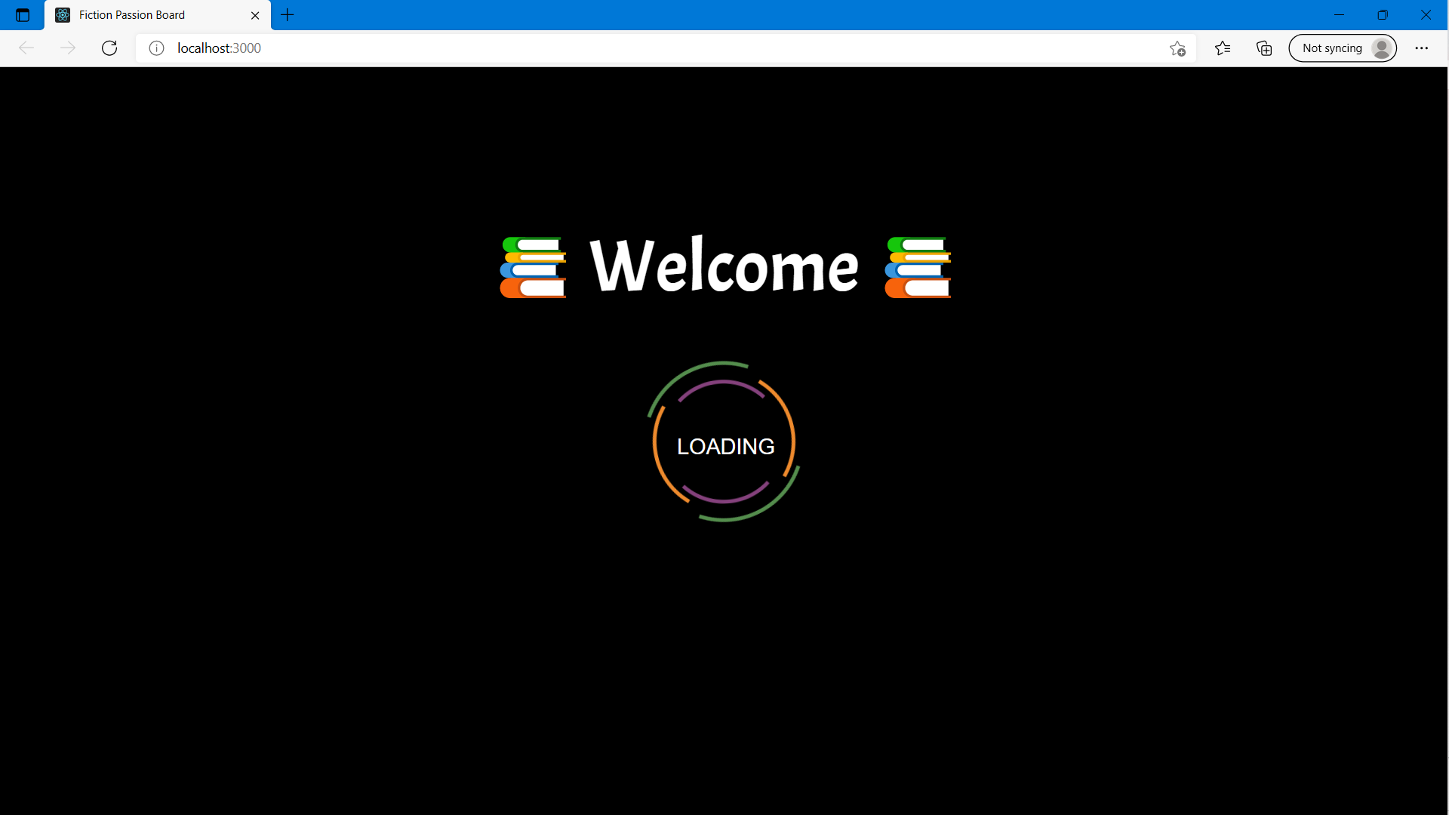

Slide 12
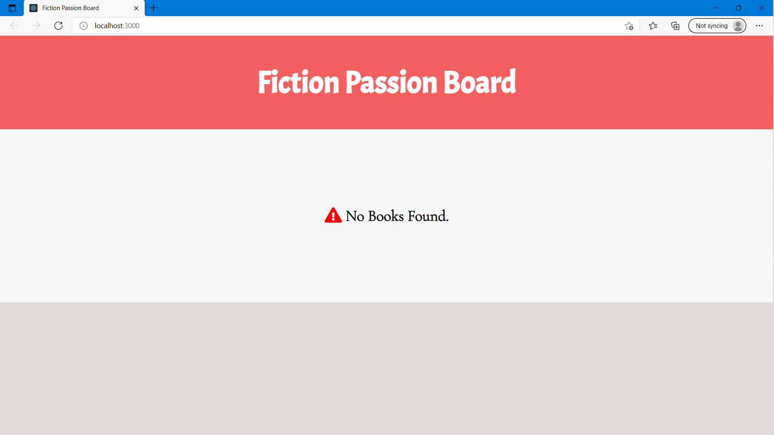

Slide 13
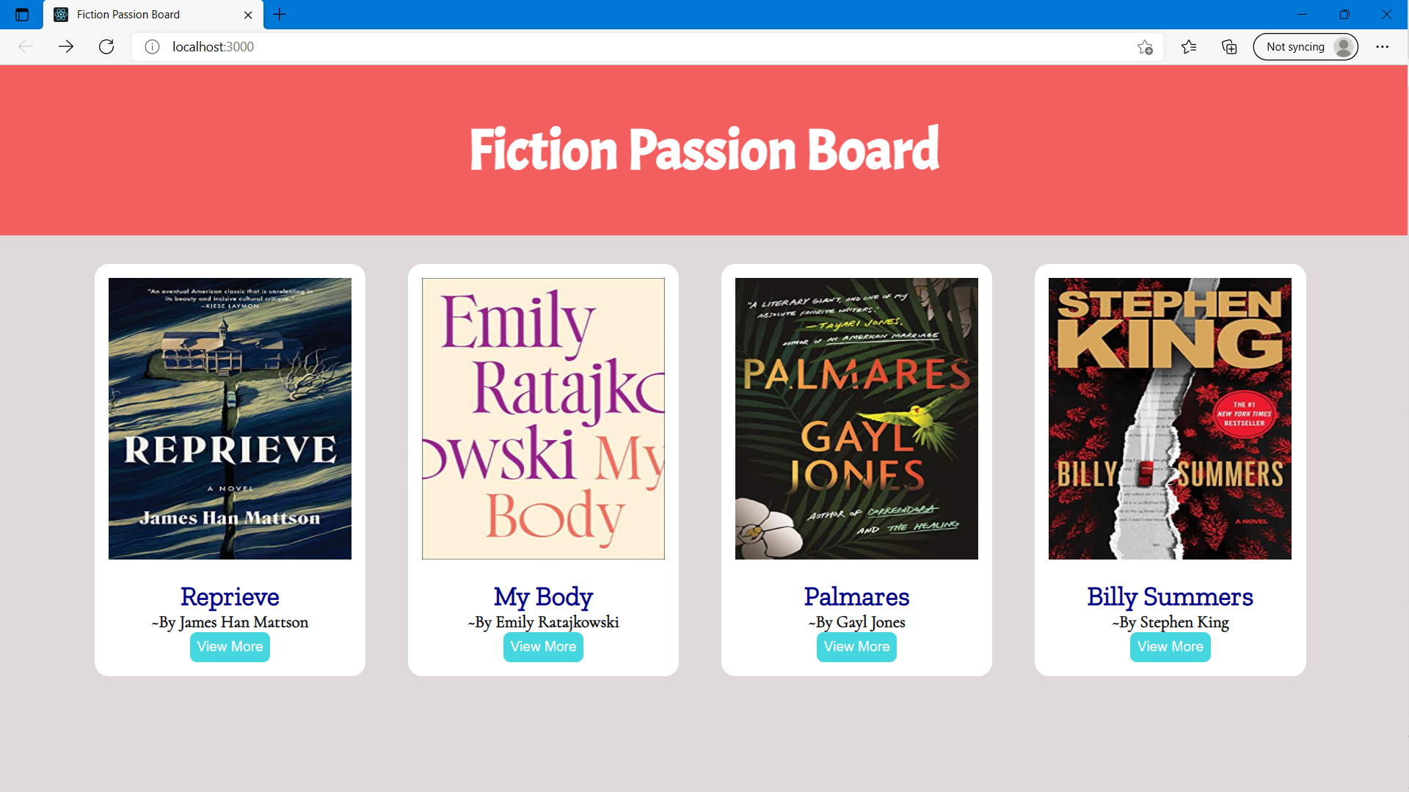

Slide 14
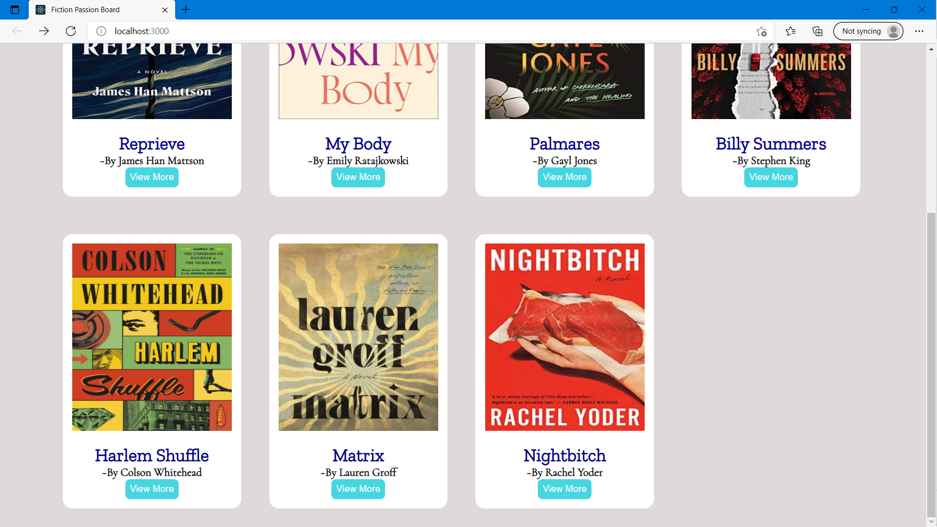

Slide 15
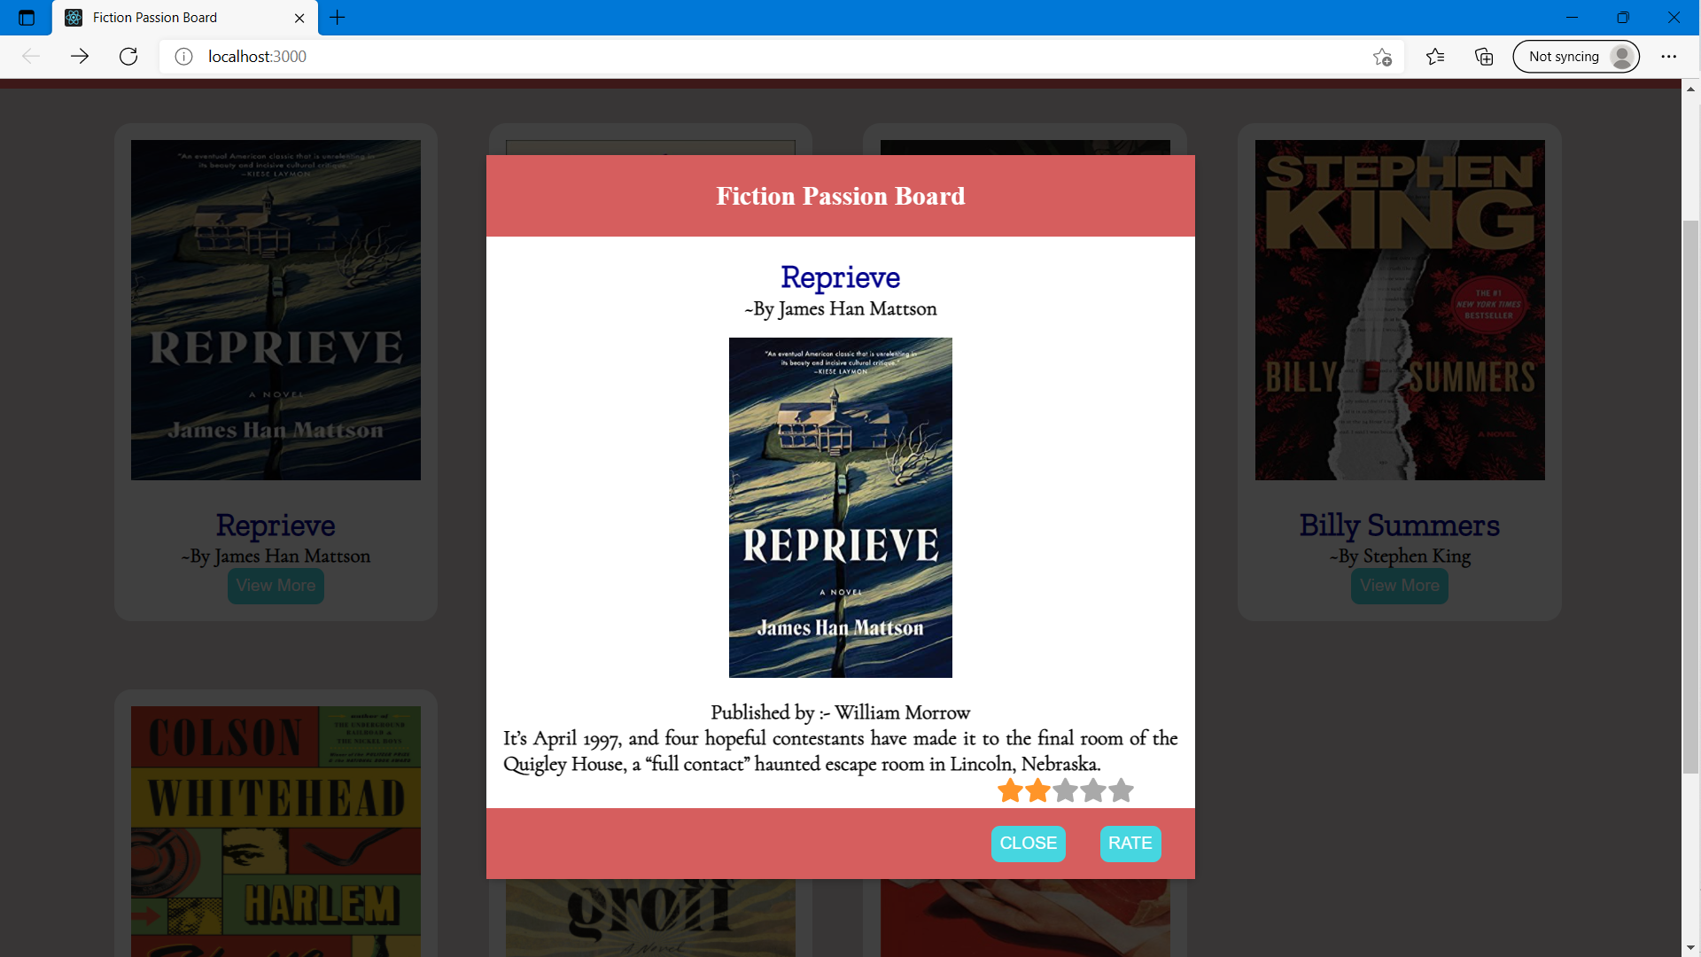

Slide 16
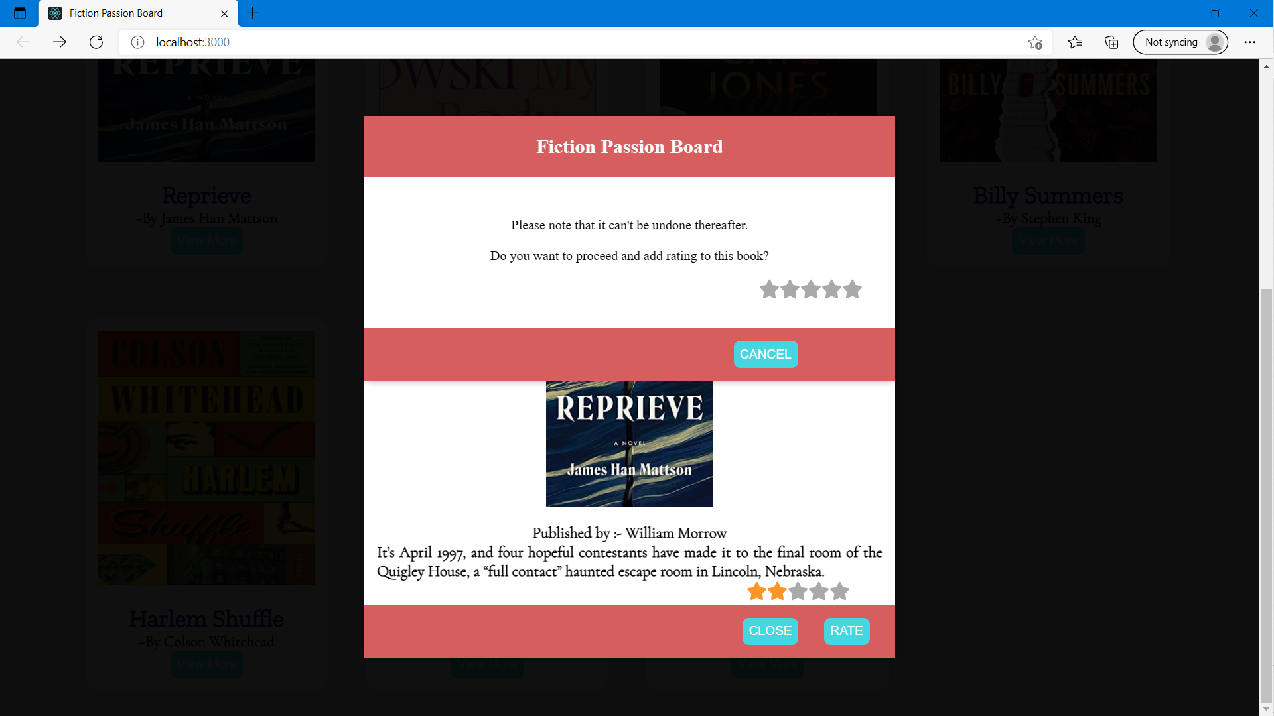

Slide 17
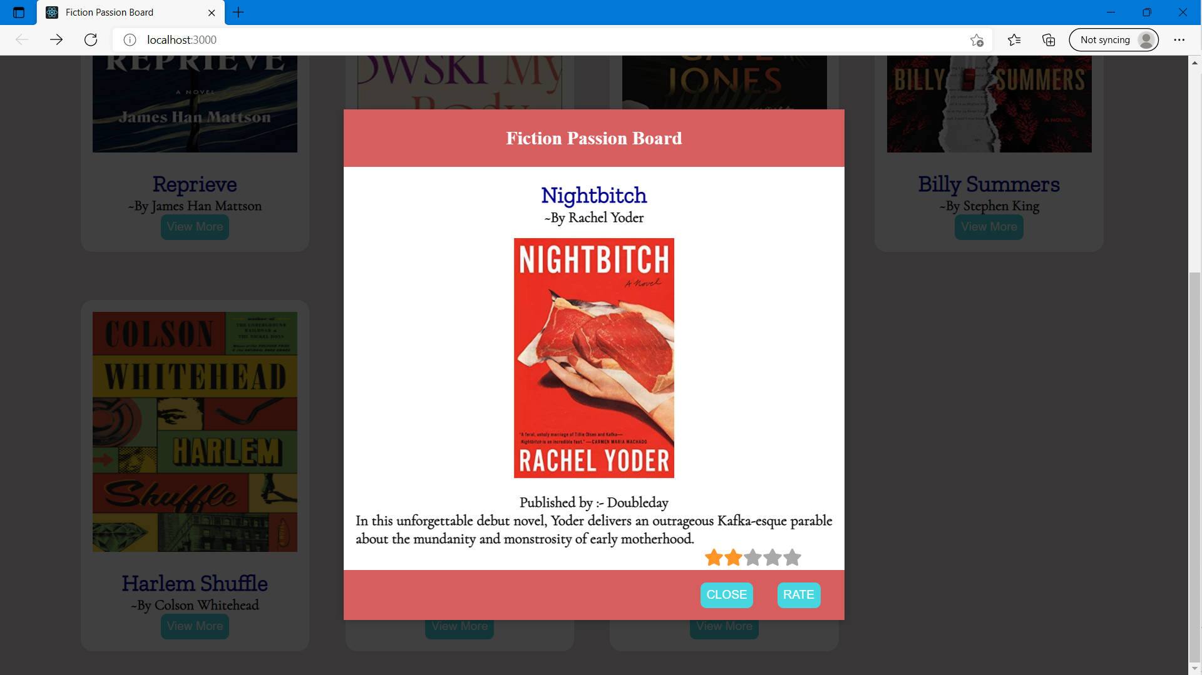

Slide 18
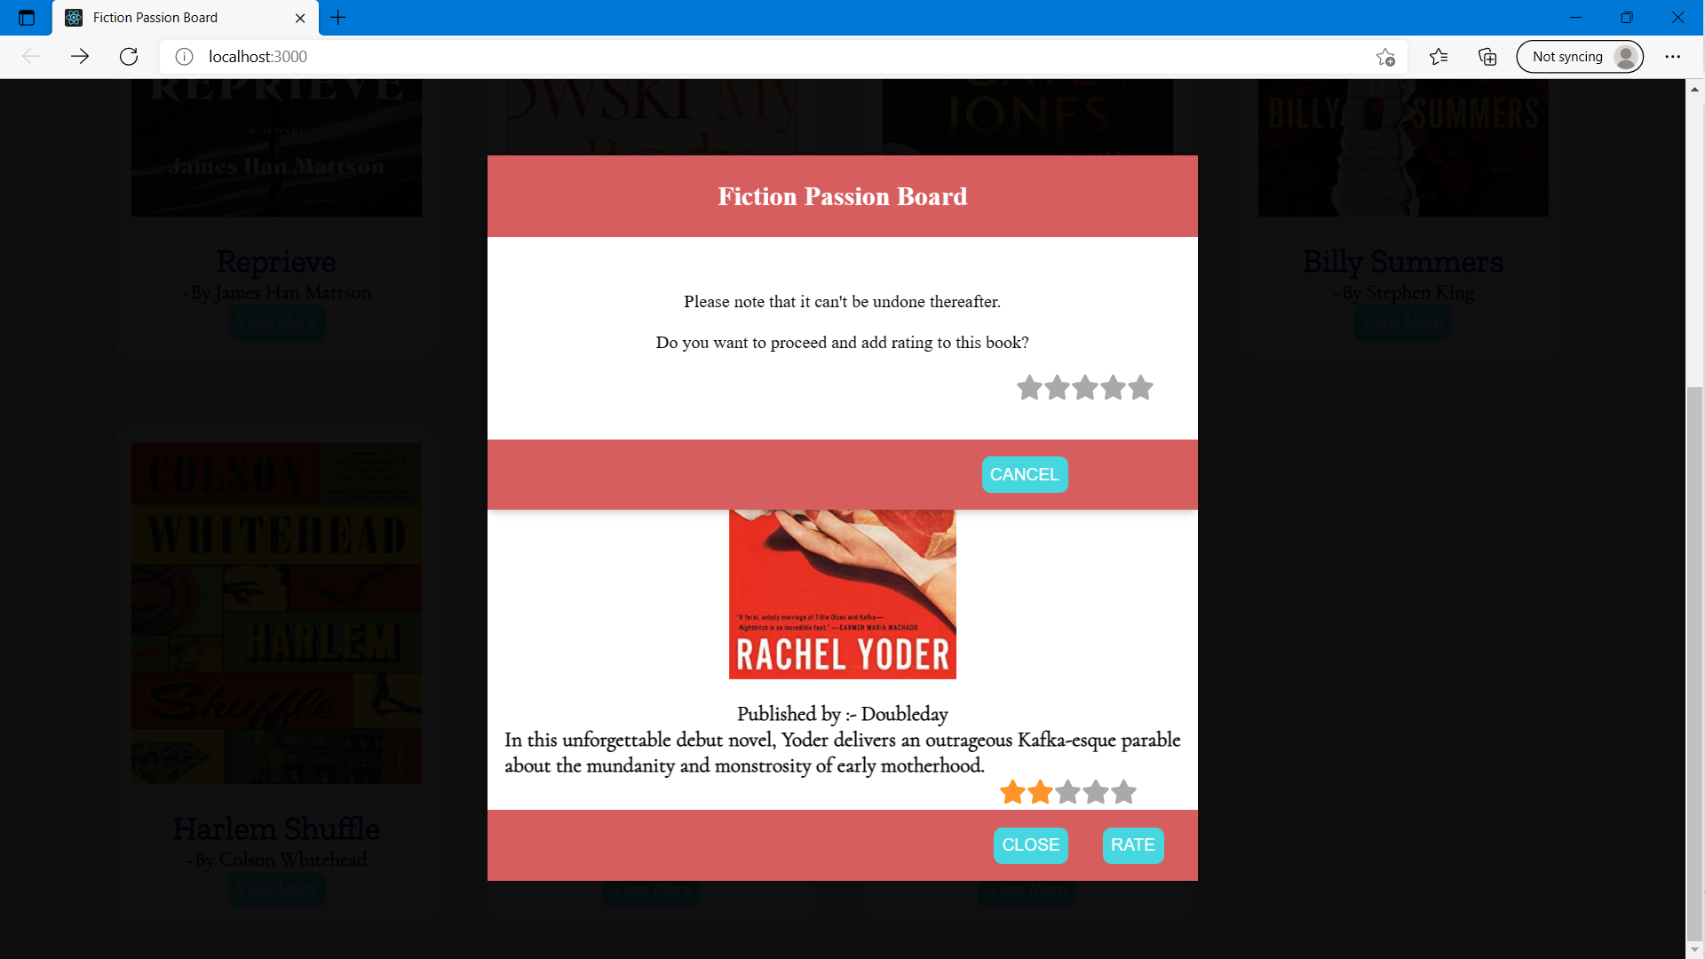

Slide 19


Slide 20
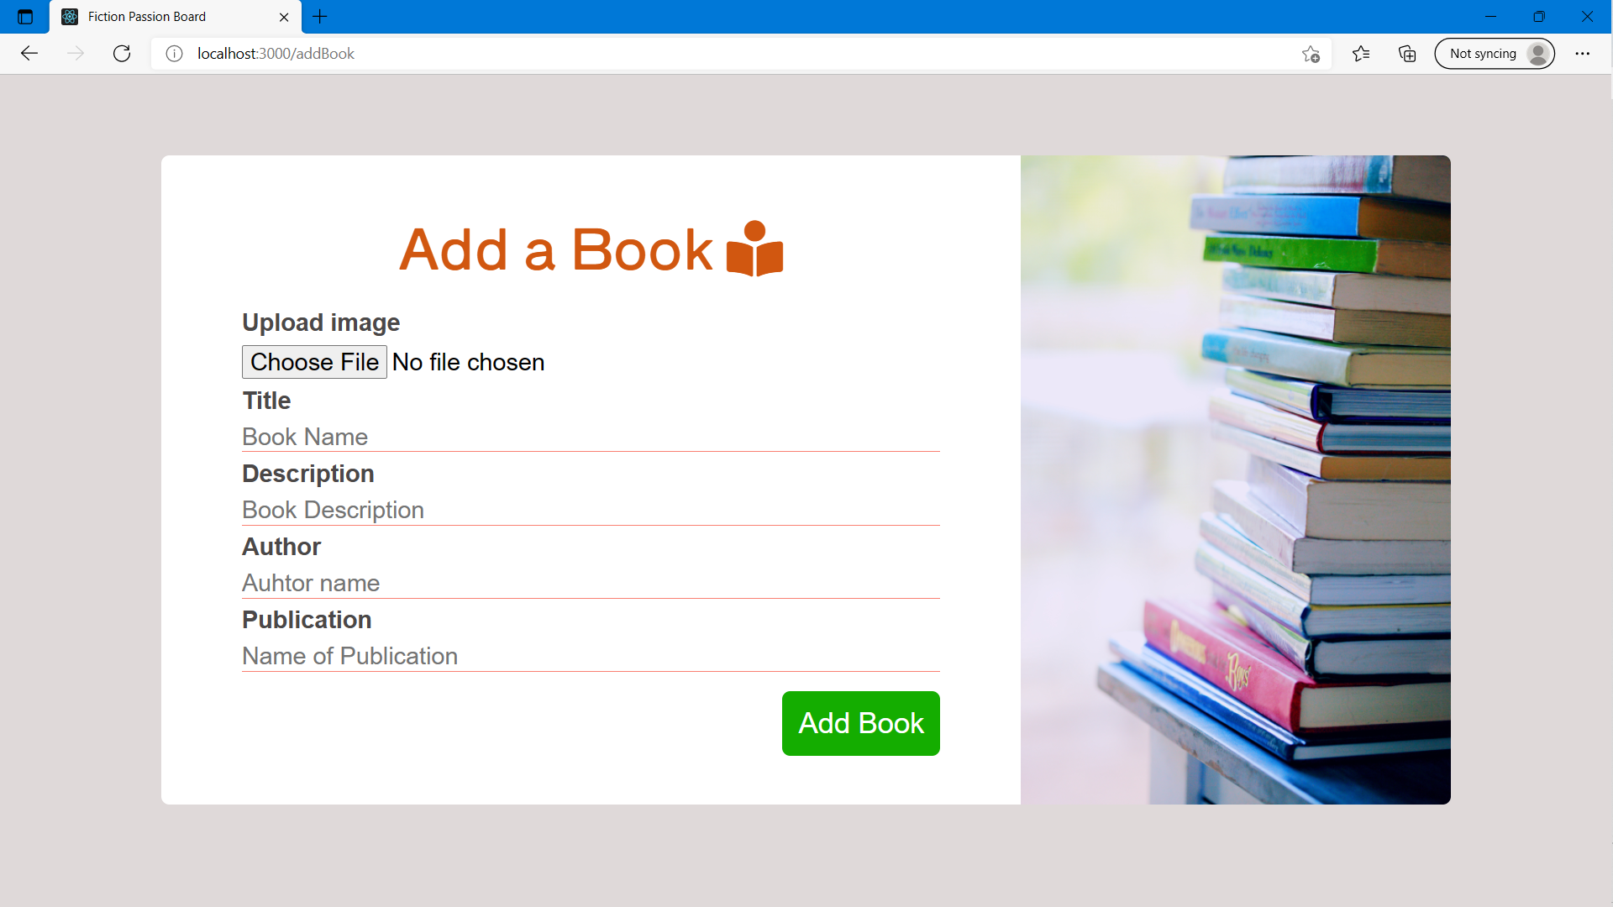

Slide 21
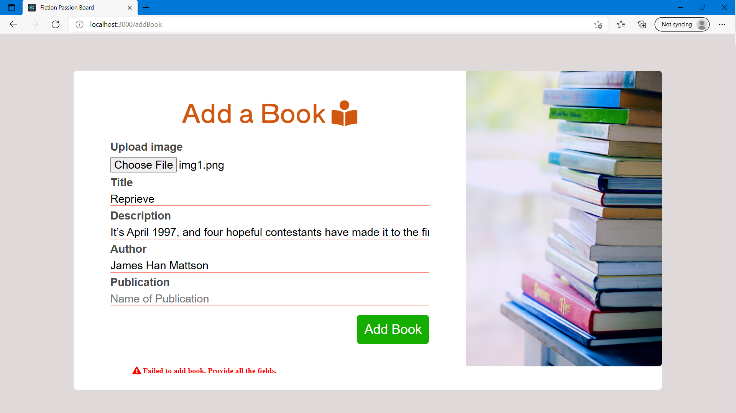

Slide 22
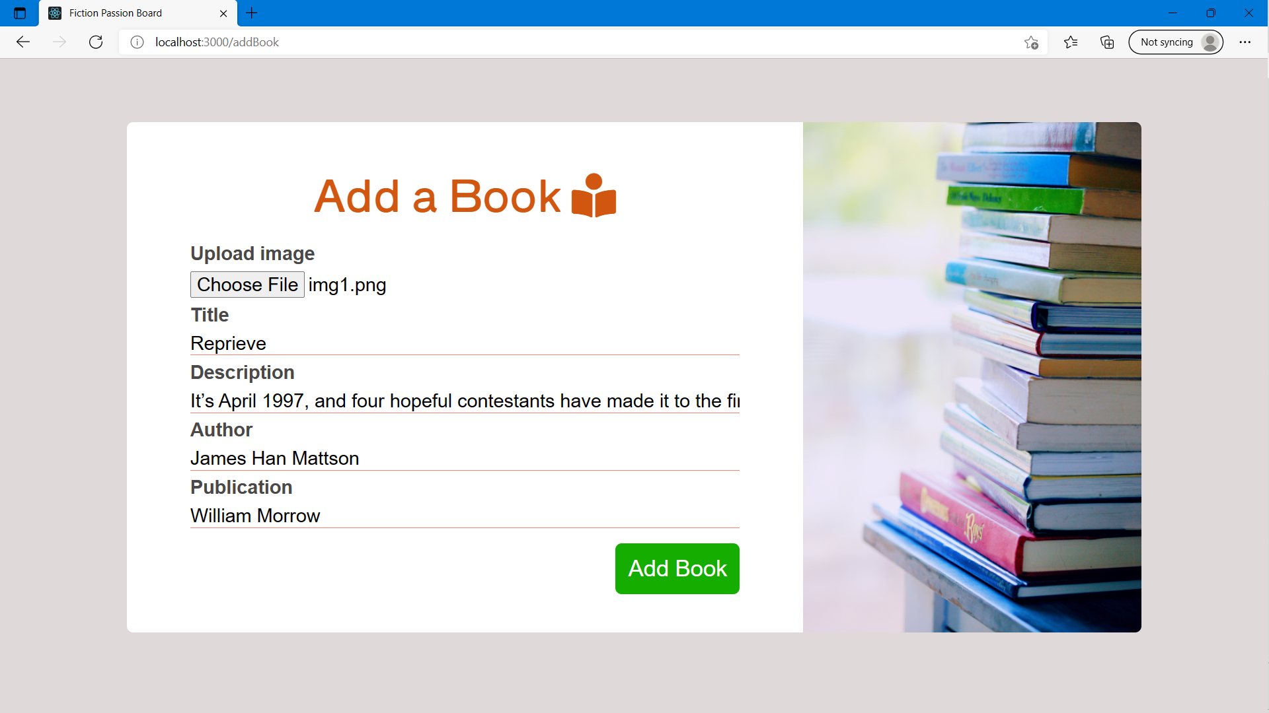

Slide 23
CREDITS
Special thanks to all the people who made this project completion successful.
Special Thanks to Mr. Amir Khan (Project Supervisor)

Slide 24
THANKS!

